Slide 1
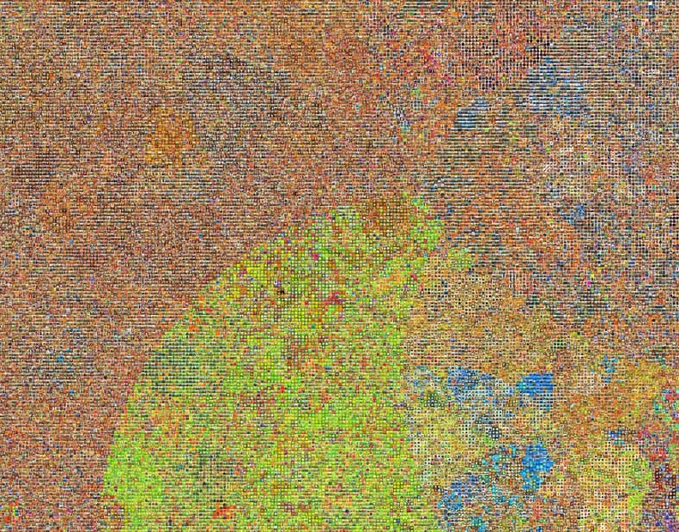
Multiclass object detection

Slide 2

Multiclass object detection

Slide 3
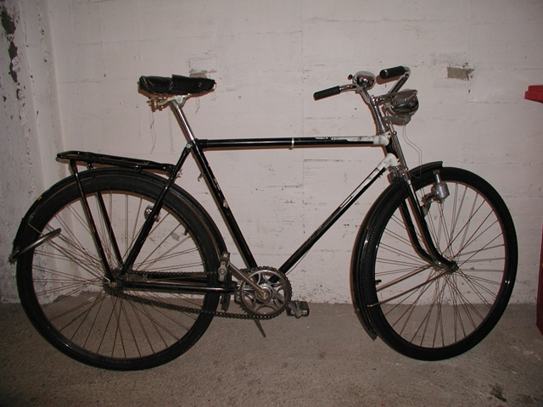
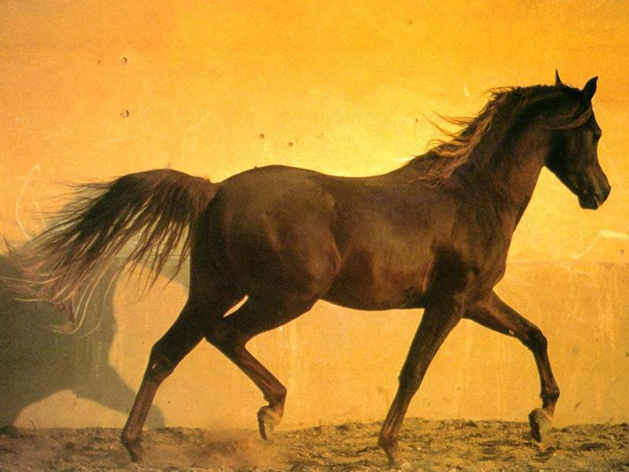
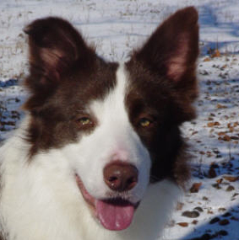
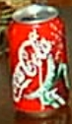

Notes:
Something happens when we have many object classes

Slide 4

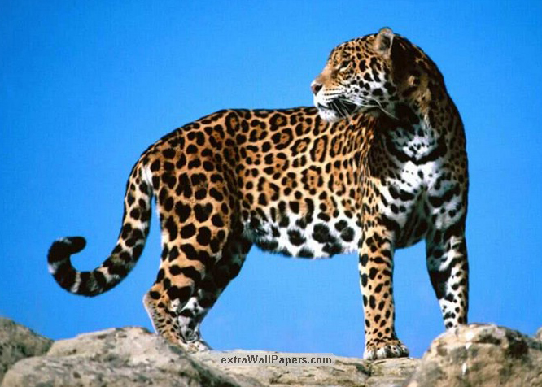
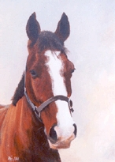


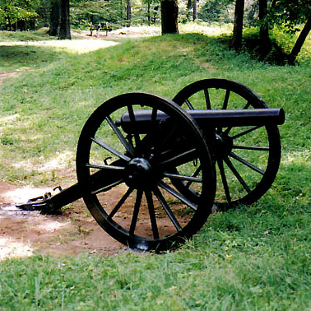


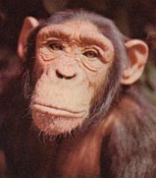
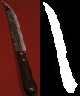


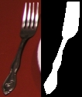
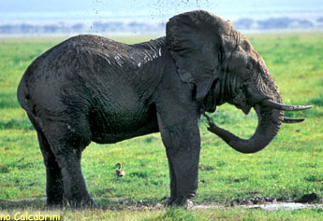
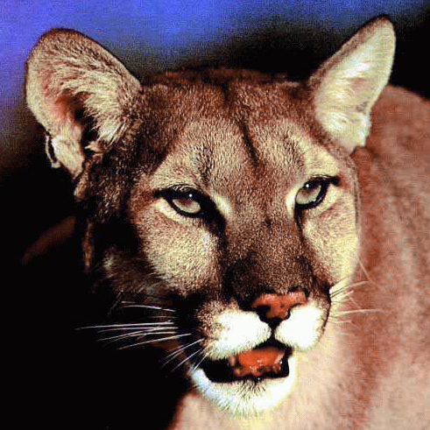

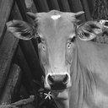

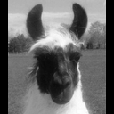




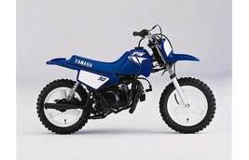
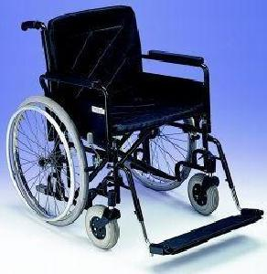



Notes:
Something happens when we have many object classes

Slide 5

Context: objects appear in configurations
Notes:
Something happens when we have many object classes

Slide 6
Generalization: objects share parts
Notes:
Something happens when we have many object classes

Slide 7
How many categories?

Slide 8
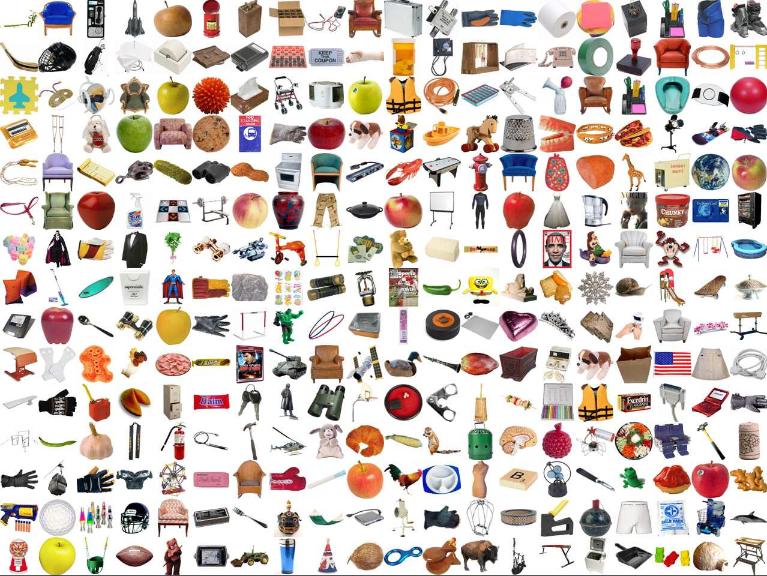
“Muchas”
Slide by Aude Oliva

Slide 9
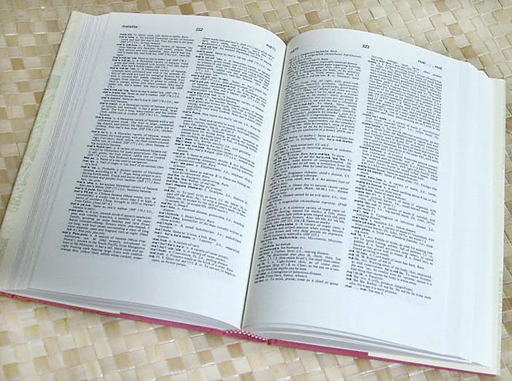

How many object categories are there?
~10,000 to 30,000
Biederman 1987

Slide 10
How many categories?
Probably this question is not even specific enough to have an answer

Slide 11
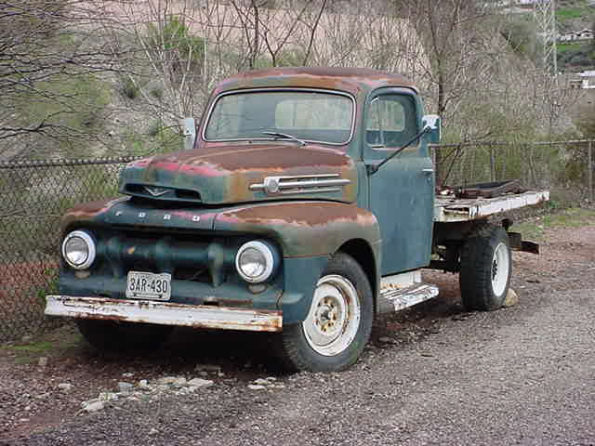
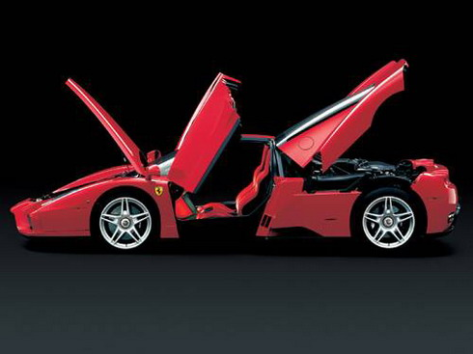

Which level of categorization is the right one?
Car is an object composed of: a few doors, four wheels (not all visible at all times), a roof,
front lights, windshield
?
If you are thinking in buying a car, you might want to be a bit more specific about
your categorization level.

Slide 12
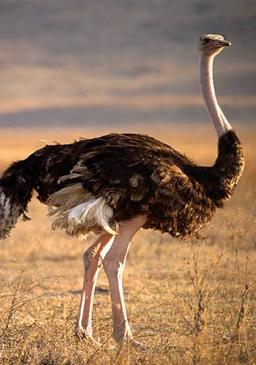
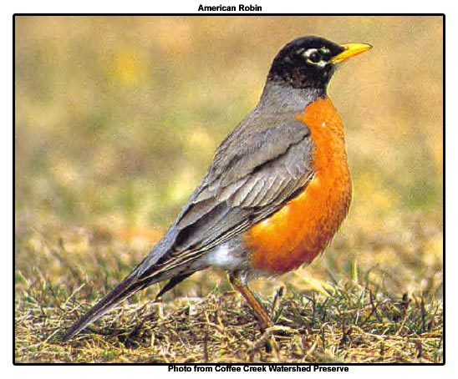
Entry-level categories (Jolicoeur, Gluck, Kosslyn 1984)
Typical member of a basic-level category are categorized at the expected level
Atypical members tend to be classified at a subordinate level.
A bird
An ostrich

Slide 13
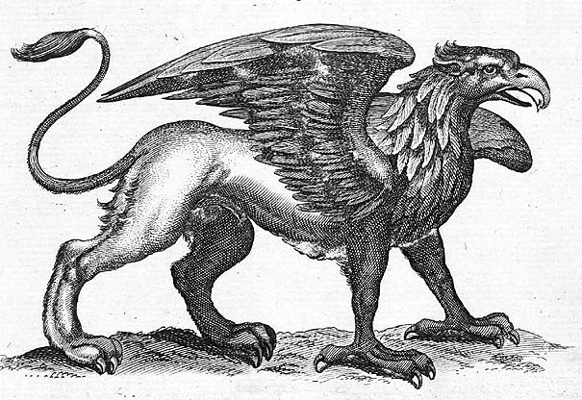
We do not need to recognize the exact category
A new class can borrow information from similar categories

Slide 14
So, where is computer vision?
Well…

Slide 15
Multiclass object detection the not so early days
Notes:
The single class age has influenced how to do multiclass object detection: just train N independent classifiers.

Slide 16
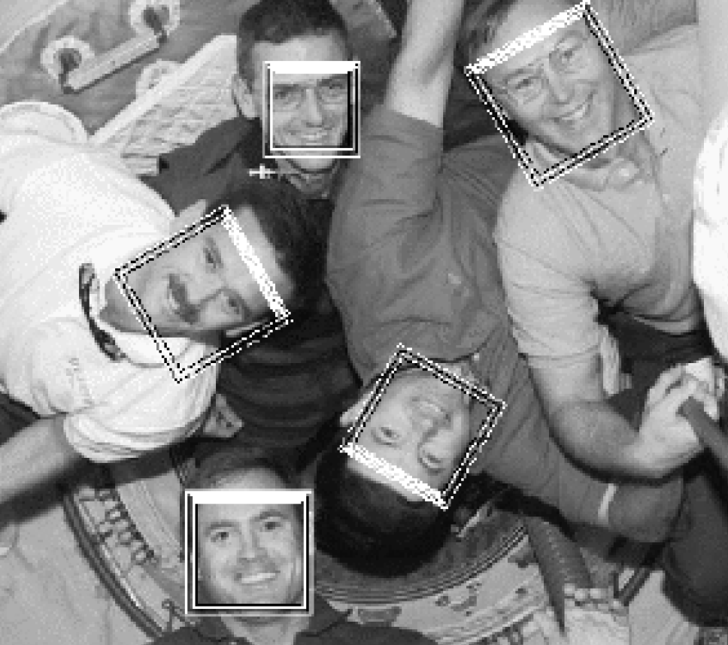
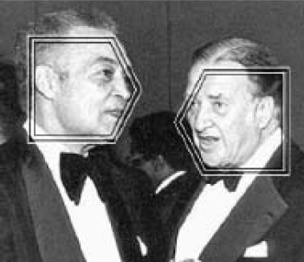
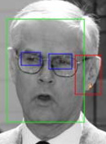


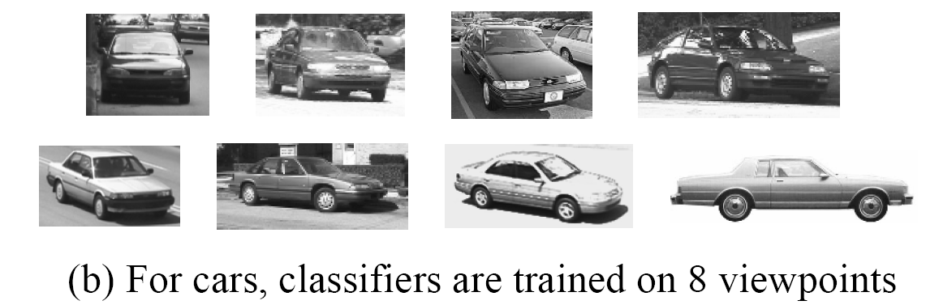
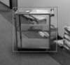
Multiclass object detection the not so early days
Using a set of independent binary classifiers was a common strategy:
Viola-Jones extension for dealing with rotations
- two cascades for each view
Schneiderman-Kanade multiclass object detection
(a) One detector for each class
There is nothing wrong with this approach if you have access to lots of training data and you do not care about efficiency.
Notes:
The single class age has influenced how to do multiclass object detection: just train N independent classifiers.

Slide 17
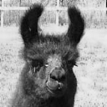
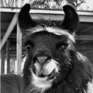
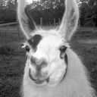
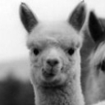
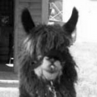
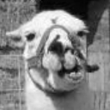
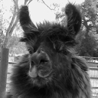
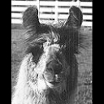
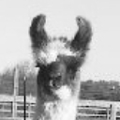
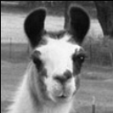
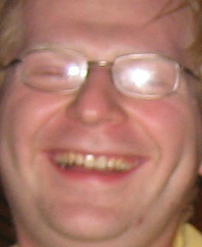
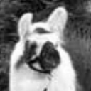
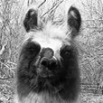

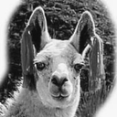
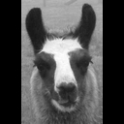
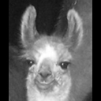
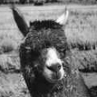
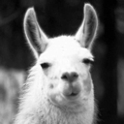
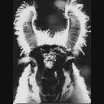
Generalizing Across Categories
Can we transfer knowledge from one object category to another?
Slide by Erik Sudderth

Slide 18

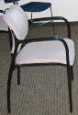
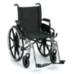
Shared features
Is learning the object class 1000 easier than learning the first?
Can we transfer knowledge from one object to another?
Are the shared properties interesting by themselves?
…
Notes:
So, in this presentation I will show some examples in which shared representations can be useful.

Slide 19

Multitask learning
R. Caruana. Multitask Learning. ML 1997
“MTL improves generalization by leveraging the domain-specific information contained in the training signals of related tasks. It does this by training tasks in parallel while using a shared representation”.
vs.
Sejnowski & Rosenberg 1986; Hinton 1986; Le Cun et al. 1989; Suddarth & Kergosien 1990; Pratt et al. 1991; Sharkey & Sharkey 1992; …
Notes:
Review of some papers that had vision applications.
The advantages of learning simultaneously multiple tasks has been probably first explored by learning techniques using neural networks.
This is a nice paper that studies several ways in which multitask learning can be useful and also provides a review of work on neural networks and learning to learn.
Sharing is done by the hidden units.

Slide 20

Multitask learning
R. Caruana. Multitask Learning. ML 1997
Primary task: detect door knobs
Tasks used:
horizontal location of doorknob
single or double door
horizontal location of doorway center
width of doorway
horizontal location of left door jamb
horizontal location of right door jamb
width of left door jamb
width of right door jamb
horizontal location of left edge of door
horizontal location of right edge of door

Slide 21
Sharing invariances
S. Thrun.Is Learning the n-th Thing Any Easier Than Learning The First? NIPS 1996
Knowledge is transferred between tasks via a learned model of the invariances of the domain: object recognition is invariant to rotation, translation, scaling, lighting, … These invariances are common to all object recognition tasks.
Toy world
With sharing
Without sharing
Notes:
He explores to algorithms: learning a distance metric and learning an internal representation.
Train a neural network with multiple outputs. Each output is one task. If similar representations are required for all functions, then the internal representation will benefit from more training data.
He also proposes learning a distance function. The distance function will put near by samples that belong to the same classe and far a part samples of different classes. If this distance is learned with many object classes, we can expect that as we add new classes the distance will change less. This distance will incorporate the invariances of the domain. He learns this distance using a Neural Network.

Slide 22

Convolutional Neural Network
Le Cun et al, 98
Translation invariance is already built into the network
The output neurons share all the intermediate levels

Slide 23

Sharing transformations
Miller, E., Matsakis, N., and Viola, P. (2000). Learning from one example through shared densities on transforms. In IEEE Computer Vision and Pattern Recognition.
Transformations are shared
and can be learnt from other tasks.
Notes:
This work is related to learning the invariants. The transformations are nuisance variables that we want to discount.

Slide 24

Sharing in constellation models
Pictorial Structures Fischler & Elschlager, IEEE Trans. Comp. 1973
SVM Detectors Heisele, Poggio, et. al., NIPS 2001
Constellation Model Fei-Fei, Fergus, Perona, ICCV 2003
Model-Guided Segmentation Mori, Ren, Efros, & Malik, CVPR 2004

Slide 25

Reusable Parts
Krempp, Geman, & Amit “Sequential Learning of Reusable Parts for Object Detection”. TR 2002
Goal: Look for a vocabulary of edges that reduces the number of features.
Examples of reused parts
Number of features
Number of classes

Slide 26

















Specific feature
pedestrian
chair
Traffic light
sign
face
Background class
Non-shared feature: this feature
is too specific to faces.

Slide 27


Shared feature
shared feature

Slide 28




Additive models and boosting
Independent binary classifiers:
Screen detector
Car detector
Face detector
Binary classifiers that share features:
Screen detector
Car detector
Face detector
Torralba, Murphy, Freeman. CVPR 2004. PAMI 2007
Notes:
Strees: the main part is not to discriminate among classes. The hard part is to detect the objects when inmersed in clutter.

Slide 29
50 training samples/class
29 object classes
2000 entries in the dictionary
Results averaged on 20 runs
Error bars = 80% interval
Class-specific features
Shared features
Torralba, Murphy, Freeman. CVPR 2004. PAMI 2007

Slide 30



Generalization as a function of object similarities
12 unrelated object classes
12 viewpoints
K = 2.1
K = 4.8
Area under ROC
Area under ROC
Number of training samples per class
Number of training samples per class
Torralba, Murphy, Freeman. CVPR 2004. PAMI 2007

Slide 31



J. Shotton, A. Blake, R. Cipolla. Multi-Scale Categorical Object Recognition Using Contour Fragments. In IEEETrans. on PAMI, 30(7):1270-1281, July 2008.
Efficiency
Generalization
Opelt, Pinz, Zisserman, CVPR 2006
Notes:
These results have been reproduced by opelt with a completely different set of features, and they found the same sublinear scaling for the complexity and the same improved generalization. Although the increase is weak because they use few categories

Slide 32
Sharing patches
Bart and Ullman, 2004
For a new class, use only features similar to features that where good for other classes:
Proposed Dog
features

Slide 33
Some more references
Baxter 1996
Caruana 1997
Schapire, Singer, 2000
Thrun, Pratt 1997
Krempp, Geman, Amit, 2002
E.L.Miller, Matsakis, Viola, 2000
Mahamud, Hebert, Lafferty, 2001
Fink et al. 2003, 2004
LeCun, Huang, Bottou, 2004
Holub, Welling, Perona, 2005
…

Slide 34
Modeling object relationships

Slide 35

The “guess what I am trying to detect” challenge
The detector challenge: by looking at the output of a detector on a random set of images, can you guess which object is it trying to detect?

Slide 36
What object is detector trying to detect?
The detector challenge: by looking at the output of a detector on a random set of images, can you guess which object is it trying to detect?

Slide 37

1. chair, 2. table, 3. road, 4. road, 5. table, 6. car, 7. keyboard.
Notes:
Just trying to do object detection is not enough. We need to reason about the scene, about object coocurrences, etc. To learn about this things we need data. This is why we started labelme, to create a big database of annotated scenes, with many objects per image.

Slide 38
The context challenge
How far can you go without using an object detector?

Slide 39


What are the hidden objects?
1
2

Slide 40
What are the hidden objects?
Chance ~ 1/30000

Slide 41

objects
image
p(O | I) αp(I|O) p(O)
Object model
Context model

Slide 42
p(O | I) αp(I|O) p(O)
Object model
Context model
Full joint
Scene model
Aprox. joint

Slide 43
p(O | I) αp(I|O) p(O)
Object model
Context model
Full joint
Approx. joint
Scene model

Slide 44


p(O | I) αp(I|O) p(O)
Object model
Context model
Full joint
Scene model
Approx. joint
p(O) = Σ Πp(Oi|S=s) p(S=s)
s
i
office
street

Slide 45
p(O | I) αp(I|O) p(O)
Object model
Context model
Full joint
Scene model
Approx. joint

Slide 46


Pixel labeling using MRFs
Enforce consistency between neighboring labels, and between labels and pixels
O_{i}
Carbonetto, de Freitas & Barnard, ECCV’04

Slide 47


Beyond nearest-neighbor grids
Most MRF/CRF models assume nearest-neighbor graph topology
This cannot capture long-distance correlations

Slide 48



Object-Object Relationships
Use latent variables to induce long distance correlations between labels in a Conditional Random Field (CRF)
He, Zemel & Carreira-Perpinan (04)

Slide 49


Object-Object Relationships
[Kumar Hebert 2005]

Slide 50

Object-Object Relationships
Fink & Perona (NIPS 03)
Use output of boosting from other objects at previous iterations as input into boosting for this iteration

Slide 51


Objects in Context
Building, boat, person
Road
Building,
boat, motorbike
Water,
sky
Building
Most consistent labeling according to object co-occurrences& locallabel probabilities.
Road
Boat
Water
A. Rabinovich, A. Vedaldi, C. Galleguillos, E. Wiewiora and S. Belongie. Objects in Context. ICCV 2007

Slide 52



Objects in Context: Contextual Refinement
Building
Contextual model based on co-occurrences
Try to find the most consistent labeling with high posterior probability and high mean pairwise interaction.
Use CRF for this purpose.
Road
Boat
Water
Independent
segment classification
Mean interaction of all label pairs
Φ(i,j) is basically the observed label co-occurrences in training set.
Slide by GokberkCinbis

Slide 53
Detecting difficult objects
Maybe
there is
a mouse
Office
Start recognizing the scene
Torralba, Murphy, Freeman. NIPS 2004.

Slide 54
Detecting difficult objects
Detect first simple objects (reliable detectors) that provide strong
contextual constraints to the target (screen -> keyboard -> mouse)
Torralba, Murphy, Freeman. NIPS 2004.

Slide 55
Detecting difficult objects
Detect first simple objects (reliable detectors) that provide strong
contextual constraints to the target (screen -> keyboard -> mouse)
Torralba, Murphy, Freeman. NIPS 2004.

Slide 56


BRF for car detection: topology
Torralba Murphy Freeman (2004)

Slide 57


BRF for car detection: results
Torralba Murphy Freeman (2004)

Slide 58


A “car” out of context is less of a car
From image
Thresholded beliefs
From detectors
Car
Building
Road
b
F
G
b
F
G
b
F
G

Slide 59



Contextual object relationships
Carbonetto, de Freitas & Barnard (2004)
Kumar, Hebert (2005)
Torralba Murphy Freeman (2004)
E. Sudderth et al (2005)
Fink & Perona (2003)

